Slide 1
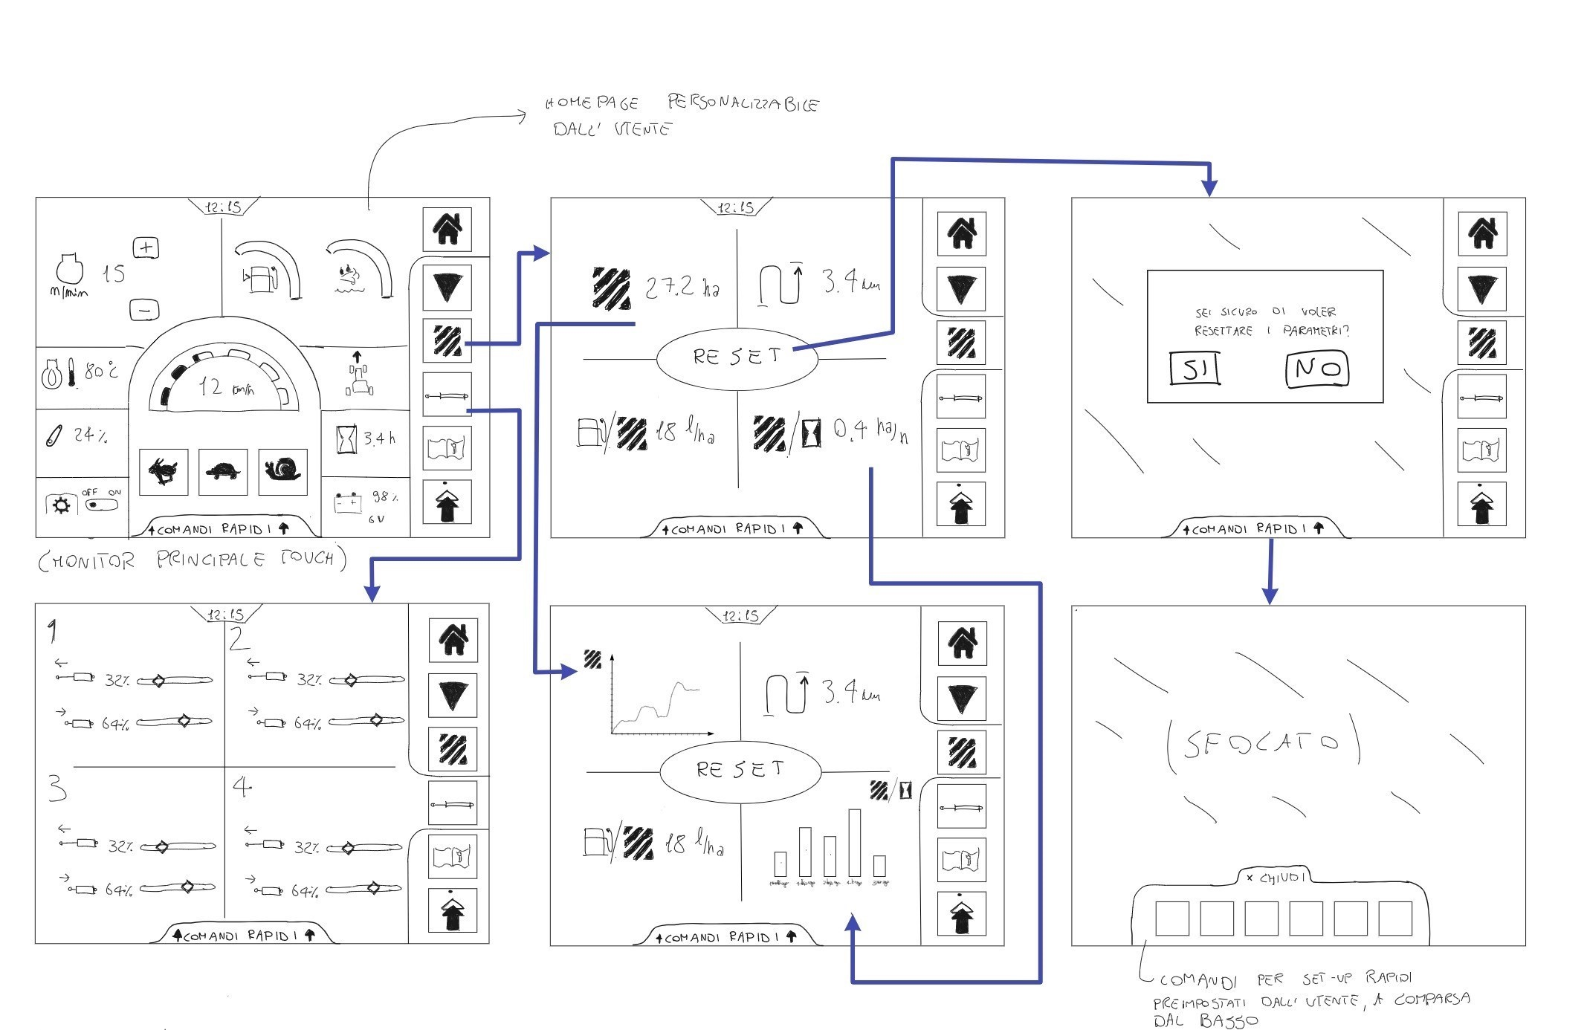
DELIVERABLE 2 /
Wireframe HMI
Application Control System
DesignLab / Andrea D’Angelo, Thomas Gabriele Merolla, Giammarco Minotti , Lorenzo Calvano

Slide 2
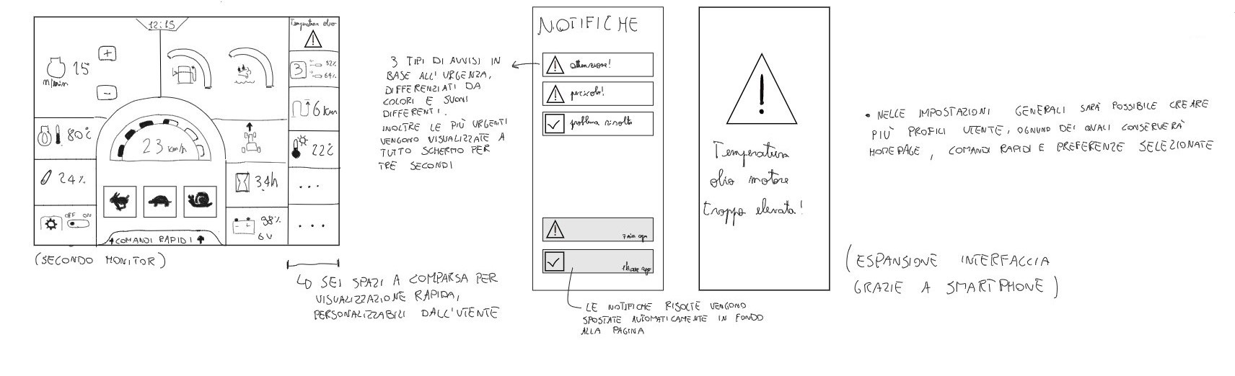
DELIVERABLE 2 /
Wireframe HMI
Application Control System
DesignLab / Andrea D’Angelo, Thomas Gabriele Merolla, Giammarco Minotti , Lorenzo Calvano

Slide 3
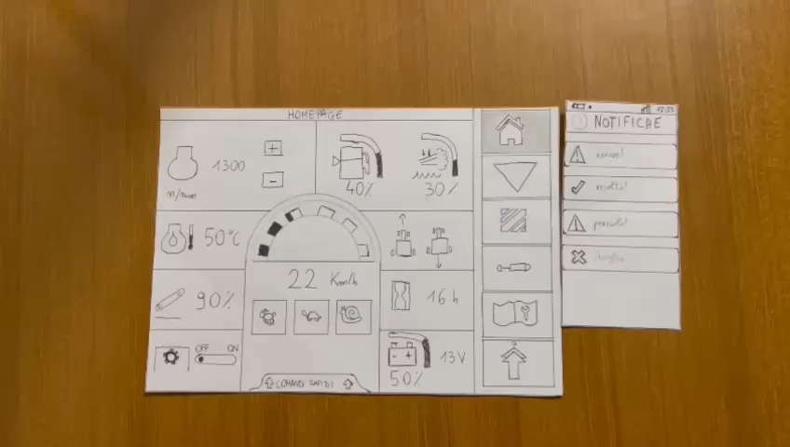
Application Control System
DELIVERABLE 2 /
Paper prototype HMI
Inserire video paper prototype
DesignLab / Andrea D’Angelo, Thomas Gabriele Merolla, Giammarco Minotti , Lorenzo Calvano

Slide 4
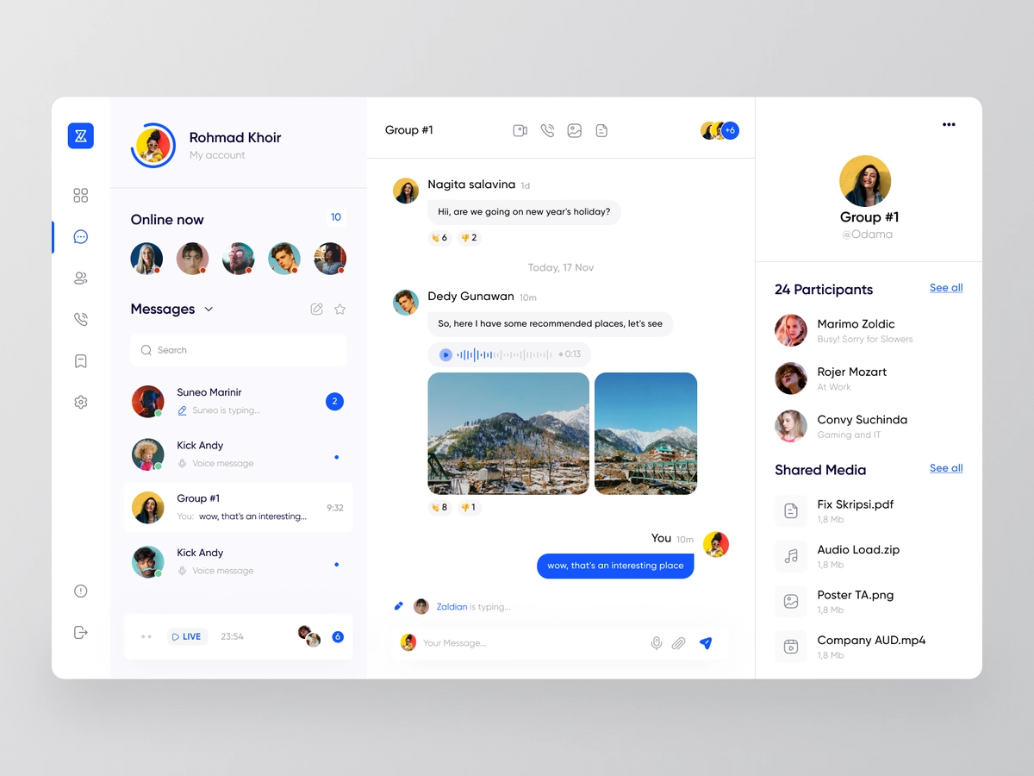
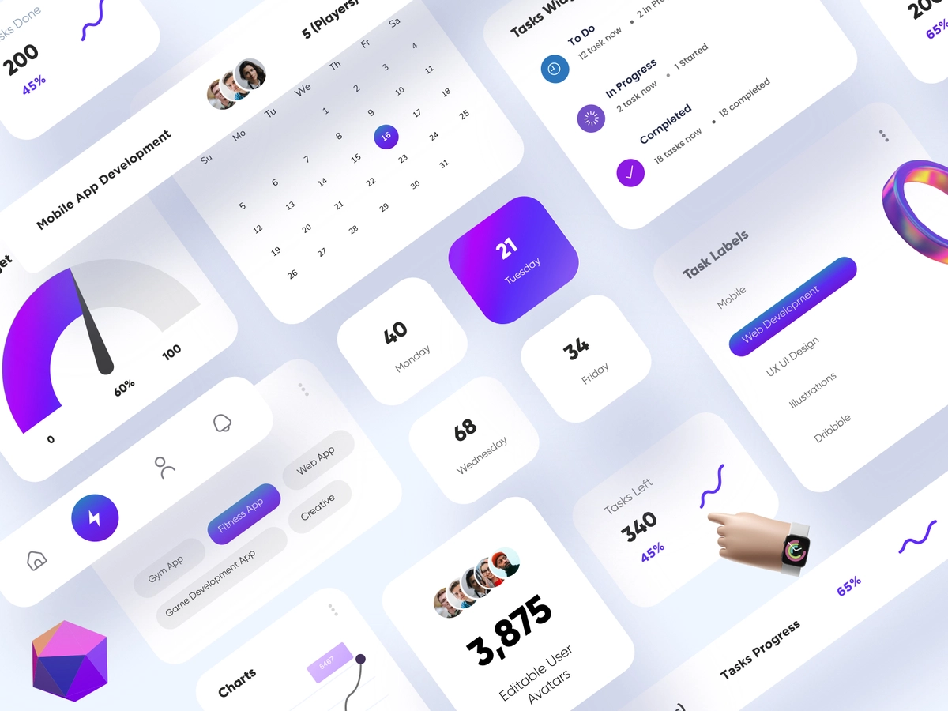
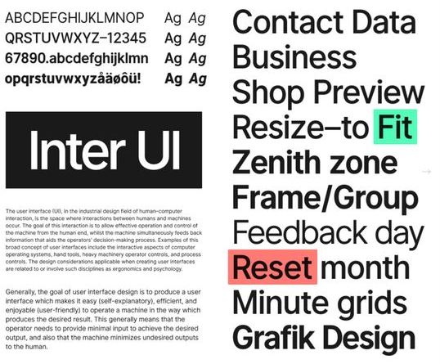

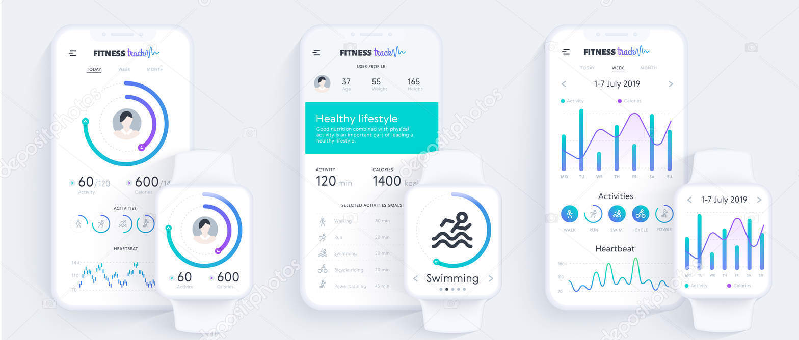

DELIVERABLE 2 /
Moodboard HMI
Application Control System
Colori ‘aggiuntivi’
DesignLab / Andrea D’Angelo, Thomas Gabriele Merolla, Giammarco Minotti , Lorenzo Calvano

